Slide 1
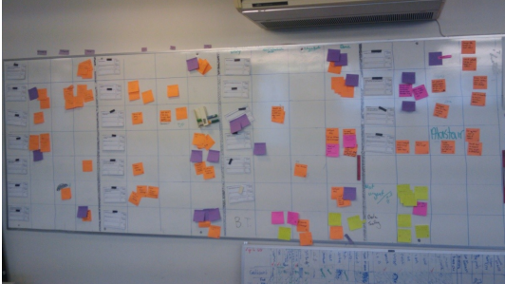
A real agile project
Project Storm (Strode, 2012).
Andrew Graff

Slide 2
Describe Project Storm
Project Storm was about replacing a legacy system (vms) that was used to capture environmental data
A single project with seven sub projects
Migrating very important and 30 years' worth of data from the old stream to new stream
Replacing legacy server/software
Fixed budget, 18 month timeframe
Culture change

Slide 3
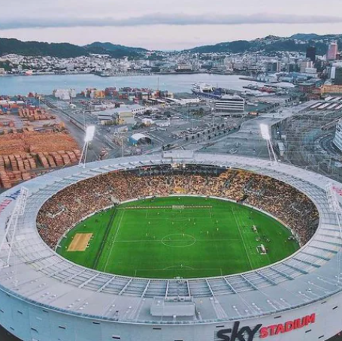
When and where did it happen
Around mid-2008
Organisation was a small State-Owned-Enterprise
Wellington, NZ

Slide 4
What sort of Project was it?
Strategic/Migration type project (software development)
Not a traditional business project but a project very critical to the organisation, the public, NZ businesses and international community
Agile approach to change the system as requested by an external contractor hired by the firm (experienced project manager)
Complex project

Slide 5
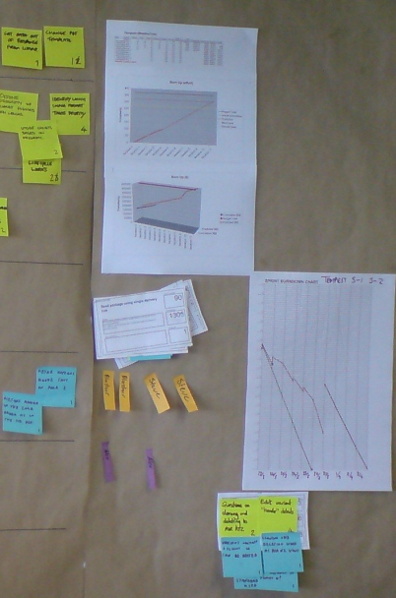
What agile practices and roles did the team use in their work
Scrum method (some xp)
This practice involved the team to work as one and in one room
Communicative and practical with change
Front end and back end worked from the same wallboard
One-week iterations/Backlogs/Burndown charts

Slide 6
References
Strode, D. 2012. A theory of coordination in agile software development projects. Victoria University of Wellington. Strode PhD Case Descriptions.pdf (weltec.ac.nz)

